Slide 1



Hardware and Software Fundamentals of
Intelligent Computing
Systems

Slide 2
Lecture 33: Model Parallelism III
(Hybrid Parallelism)

Slide 3
Hybrid Parallelism
  3D Parallelism
  5D Parallelism
Automatic Model Parallelism
  FlexFLow
  Alpa
  Etc.

Slide 4
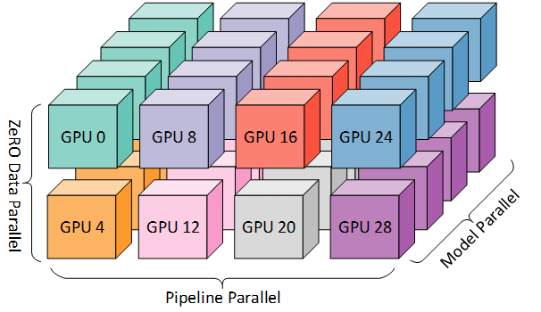
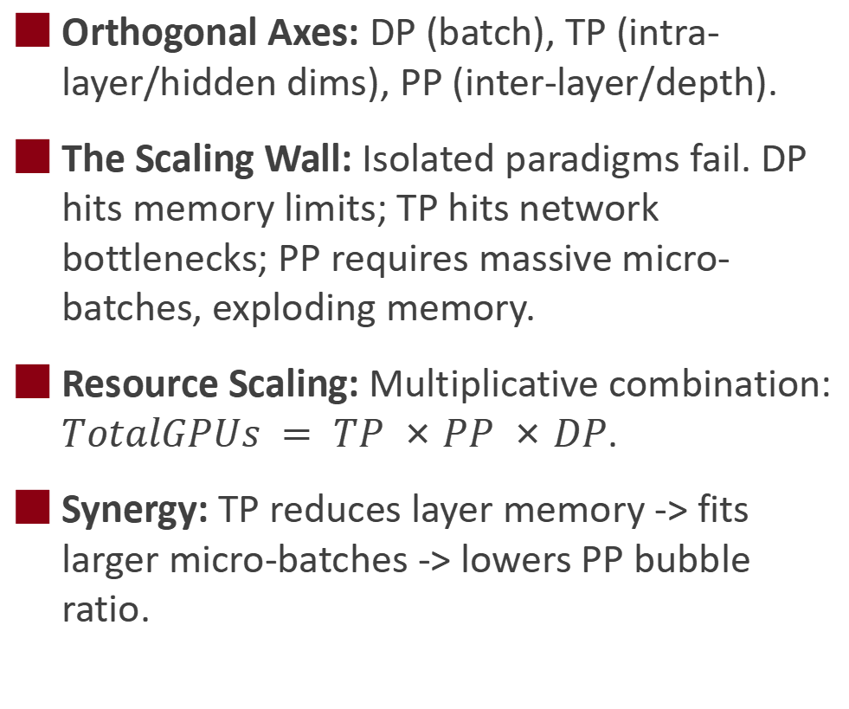
Mathematical Orthogonality of Hybrid Parallelism
Orthogonal Axes: DP (batch), TP (intra-layer/hidden dims), PP (inter-layer/depth).
The Scaling Wall: Isolated paradigms fail. DP hits memory limits; TP hits network bottlenecks; PP requires massive micro-batches, exploding memory.
Resource Scaling: Multiplicative combination: $TotalGPUs = TP ×PP ×DP$.
Synergy: TP reduces layer memory -> fits larger micro-batches -> lowers PP bubble ratio.

Slide 5
3D Parallelism System Architecture
Hardware Symbiosis: Nests DP, PP, and TP to match data center topologies.
Inner Loop (TP): Confined to a single node via NVLink for heavy MatMul communication.
Intermediate Loop (PP): Scales across nodes via RDMA for low-bandwidth stage boundaries.
Outer Loop (DP): Wraps TP+PP logically, scaling globally for massive batch throughput.
Parallelism Dimension | Execution Granularity | Communication Primitive | Physical Mapping
Tensor (TP) | Intra-layer Operations | Dense All-Reduce | Intra-Node (NVLink)
Pipeline (PP) | Inter-layer Stages | Peer-to-Peer Send/Recv | Inter-Node (InfiniBand)
Data (DP) | Global Batch Replicas | Sparse All-Reduce | Global Cluster

Slide 6
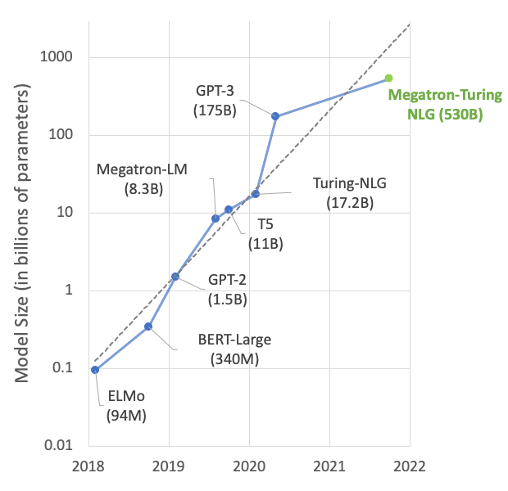
Case Study: Megatron-Turing NLG 530B
Model: 530B parameters, 105 layers, requiring >10 TB aggregate HBM.
Hardware: NVIDIA Selene Supercomputer (4480 A100 GPUs via NVSwitch/InfiniBand).
3D Configuration:
  8-way TP (intra-node) x 35-way PP (inter-node) = 280 GPUs per model replica.
  16-way DP globally (280 x 16 = 4480 GPUs).
Result: Global batch size of 1920, sustaining a historic 113 teraFLOP/s per GPU.

Slide 7
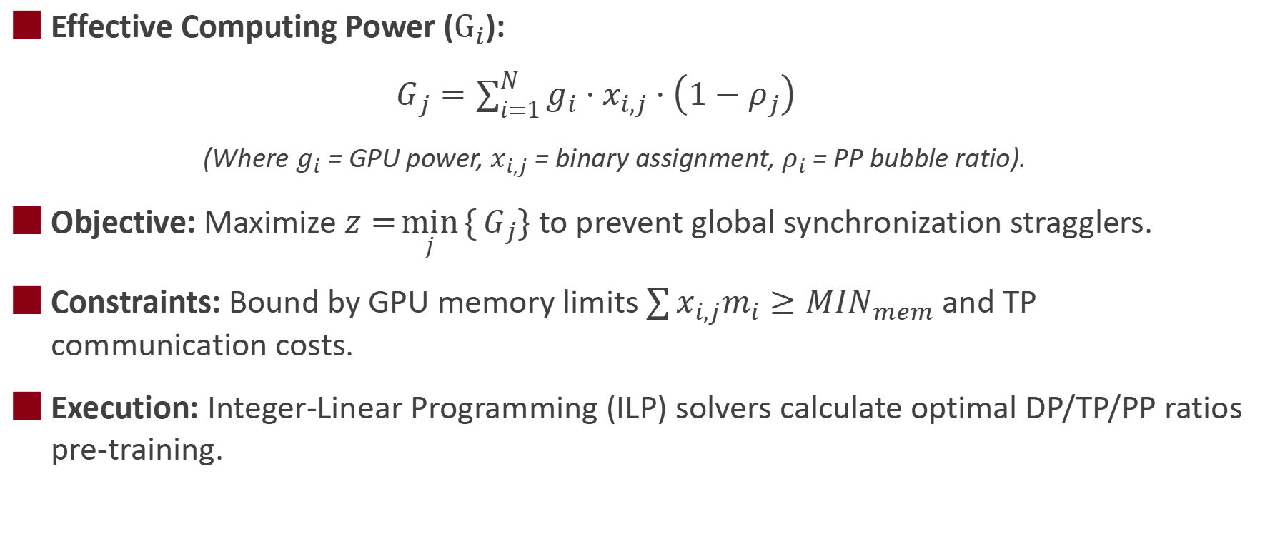
Communication Cost and Effective Power Formulation
Effective Computing Power ($G_{i}$):
$G_{j}=\sum_{i=1}^{N}{g_{i}}⋅x_{i,j}⋅\left(1−ρ_{j}\right)$
(Where $g_{i}$ = GPU power, $x_{i,j}$ = binary assignment, $ρ_{i}$ = PP bubble ratio).
Objective: Maximize $z=\min_{j}{\{}G_{j}\}$ to prevent global synchronization stragglers.
Constraints: Bound by GPU memory limits $\sum{x_{i,j}m_{i}}≥MIN_{mem}$ and TP communication costs.
Execution: Integer-Linear Programming (ILP) solvers calculate optimal DP/TP/PP ratios pre-training.

Slide 8
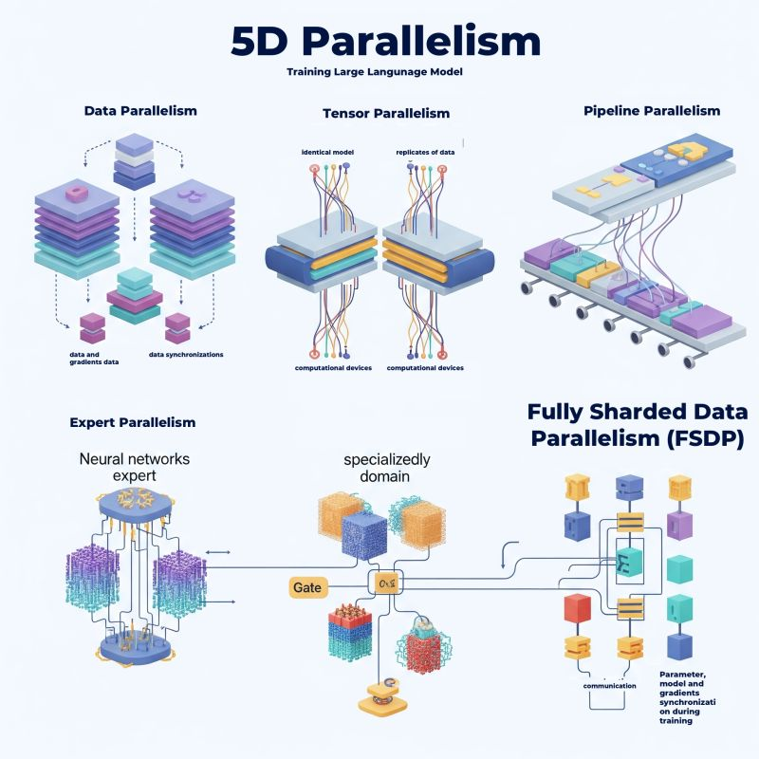
Expanding to 4D and 5D Parallelism: CP and EP
The Catalyst: Massive sequence lengths and Mixture of Experts (MoE) break 3D parallelism.
Context Parallelism (CP): Partitions tokens across GPUs, exchanging KV states via ring protocols to prevent sequence-induced OOM.
Expert Parallelism (EP): Uses All-to-All routing to dynamically dispatch tokens to discrete MoE experts.
The 5D Formula: TotalGPUs = TP x CP x EP x PP x DP
Outcome: Fractures every bottleneck (dense weights, batch throughput, infinite context, sparse compute).

Slide 9
Overcoming ZeRO and Pipeline Integration Bottlenecks
The Conflict: ZeRO-3's dynamic All-Gather parameter fetching clashes with PP's high-frequency micro-batch switching.
The Problem: Causes a network storm of repeated parameter communications.
ZeroPP Solution: Introduces a blockwise task-interleaved PP schedule.
Mechanism: Batches micro-computations per layer before dropping weights, slashing network calls while preserving memory.

Slide 10
The Paradigm Shift to Automatic Model Parallelism
Manual Brittleness: Hardcoding primitives (All-Reduce) fails when transitioning to new architectures or asymmetric hardware.
Automatic Model Parallelism (AMP): Abstracts distribution logic into a compiler optimization problem.
Mechanism: Represents the neural network as a computation DAG and the hardware as a topology graph to automatically search for optimal sharding.
Impact: AI researchers write single-device code; compilers synthesize n-dimensional execution plans.

Slide 11
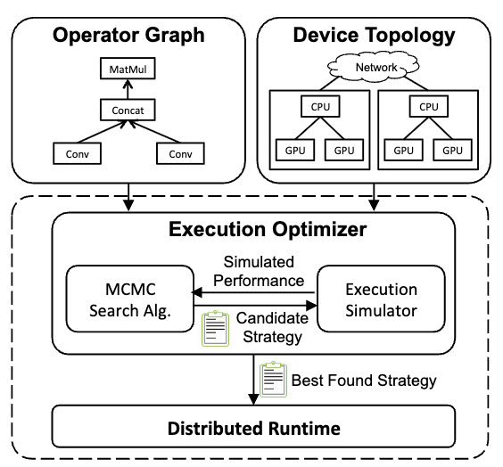
Defining the Search Space: The SOAP Framework
FlexFlow's SOAP Dimensions:
  Sample: DP (batch partitioning).
  Operation: PP (graph node distribution).
  Attribute: CP (sequence/image feature partitioning).
  Parameter: TP (weight matrix slicing).
Search Engine: Uses Markov Chain Monte Carlo (MCMC) to explore the vast configuration space.
Oracle Simulator: Predicts strategy performance in milliseconds instead of hours, discovering non-intuitive plans up to 3.3x faster than manual tuning.

Slide 12
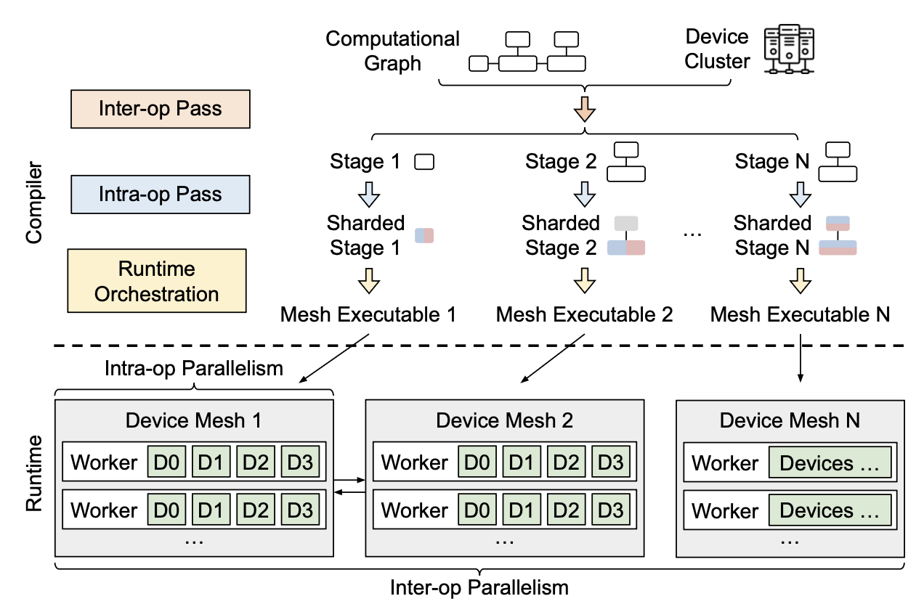
Hierarchical Space Search in Alpa
The Scaling Issue: Flat MCMC searches fail at 100B+ parameters due to exponential complexity.
Alpa's Hierarchy: Restructures the search to mirror physical data center bandwidths:
  Level 1 (Intra-op): ILP solves TP/DP assignments within high-bandwidth "device meshes" (intra-node).
  Level 2 (Inter-op): Dynamic Programming solves PP staging across distant meshes (inter-node).
Result: Outperforms specialized manual systems (e.g., DeepSpeed) by up to 9.7x on complex MoE models.

Slide 13
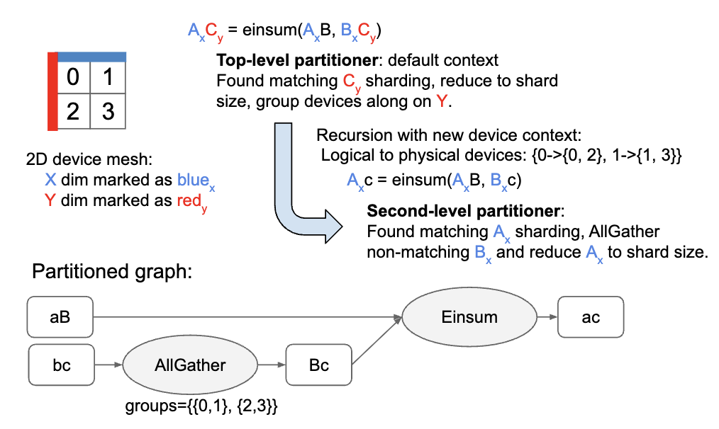
Compiler-Based SPMD Parallelization (GSPMD)
SPMD Paradigm: Essential for scaling; compiling unique programs per GPU is computationally catastrophic.
API Abstraction: Developers write single-device JAX/TF code with sparse NamedSharding hints.
XLA Completion Pass: GSPMD propagates user annotations forward and backward through the graph.
Automated Deduction: Algorithmically deduces optimal sharding for all unannotated intermediate tensors, achieving up to 62% utilization on 2048 TPU cores.

Slide 14
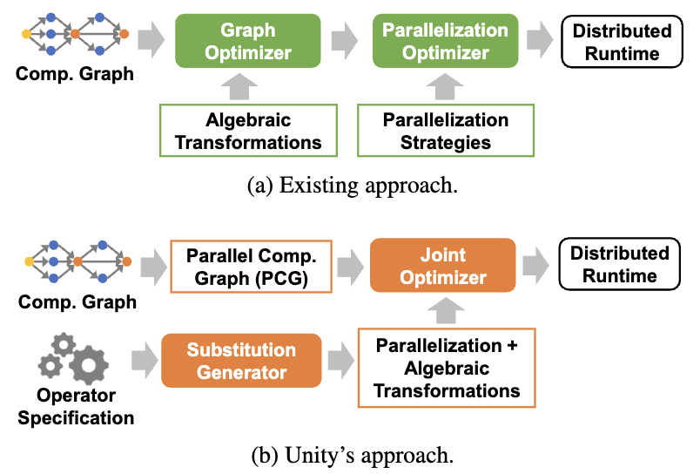
Joint Optimization of Algebra and Parallelism (Unity)
Sequential Flaw: Standard compilers fuse operators before parallelizing, which can lock out efficient network strategies.
Unity's Innovation: Jointly optimizes algebraic fusions and parallelization simultaneously via mathematical graph substitutions.
Counter-Intuitive Strategies: Unity may selectively unfuse operations to enable faster communication patterns.
Performance: Yields up to 3.6x throughput speedups over traditional sequential distributed frameworks.

Slide 15
System-Level Hybrid Strategy Search (Galvatron)
Production Focus: Tailored for massive Transformers, explicitly integrating Activation Checkpointing and ZeRO offloading.
Two-Step Workflow:
  Decision Tree: Prunes mathematically impossible strategies based on strict hardware memory budgets.
  Dynamic Programming: Assigns optimal parallelism layer-by-layer.
Accurate Cost Modeling: Uniquely accounts for GPU performance drops caused by compute/communication overlap.
Feature | FlexFlow | Alpa | Galvatron
Search Space | MCMC (SOAP) | ILP + Dynamic Programming | Decision Tree + DP
Granularity | Operator Level | Intra-op vs Inter-op | Layer-wise assignments
Optimization | Multi-dim Tensor Slicing | Bandwidth Hierarchy | Checkpointing Integration

Slide 16
The Future of Distributed Training Frameworks
The Trajectory: Moving from imperative manual engineering to declarative, fully automated compilation.
Advanced Scheduling: Evolving beyond LLM-centric limits (e.g., FlexPipe for programmable PP, Pfeife for non-sequential models).
Heterogeneous Training: Orchestrators will dynamically adapt to clusters with asymmetric memory/bandwidth profiles.
Ultimate Goal: Virtualizing hardware to democratize trillion-parameter AI, making extreme-scale training an out-of-the-box process.

Slide 17

The Solution: FlagOS, a Unified AI Software Stack

Slide 18








https://space.bilibili.com/3546791834290849
https://github.com/flagos-ai
https://www.zhihu.com/people/95-22-20-18/posts
https://flagos.io/Home

Slide 19

Thanks for your time！

